Slide 1
Introduction to Python
Chapter 1 slides

Slide 2
Introducing Python

Slide 3
What’s a Program?
We have a lot of complex tasks in data science that need to be executed with precision
We’ll have specific ways we need to crunch numbers
We’ll need to follow the right mathematical steps.
We’ll have to build persistent systems that take in data over time, store it in sensible ways, and provide output to users.
We’ll have to communicate with databases, or other computer systems in ways that they can understand.
Obviously, we’ll use computers to help us with these tasks.
A program is the set of instructions we’ll pass to the computer to tell it what to do.

Slide 4
Program vs. Algorithm
It’s helpful to think about the steps we need to take to solve a problem, as separate from the instructions.
The plan for solving a problem is what we call an algorithm.
The correct set of steps.
The method of execution.
Something you could explain in English, or maybe mathematical notation.
To communicate an algorithm to a computer, we first have to encode it in a programming language.
Algorithm
Abstract set of steps to solve a problem
Program
Instructions encoded in a programming language

Slide 5
Algorithm Example
How do you find the longest word in a list of words?
You can probably invent a pretty simple algorithm to use.
Start with a guess that’s an empty word
(this isn’t ever the right answer, but as you’ll see, we’ll always replace it)
Next, go through each other word in order.
If the word you get to is longer than your current guess, make that your new guess.
At the end, your guess will be one of the longest words.

Slide 6
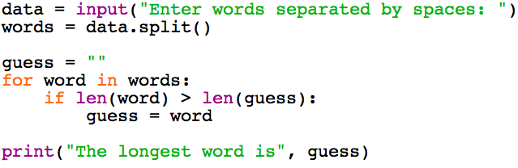
Python Implementation
Here’s the algorithm written in Python.
The first 2 lines gets the list of words and stores it in the variable words.
Notice that guess is initialized to an empty word.
For is a special statement that goes through each word in turn,
When we encounter a longer word, we set guess to the new word.
Finally, we print the answer.

Slide 7
Programming Statements
A programming language has to be more precise than a human language
There’s no room for ambiguity, we don’t want the computer to guess what we mean.
Like other programming languages, Python has a strict syntax
The rules for how to write instructions, also called statements.
The phrase, “for word in words:” has just one interpretation – every computer executing python in the world will do the exact same thing when seeing this line.
And you can’t be sloppy and change the order of the words, etc.
A human could figure out what you mean, but a computer can’t
We’ll start learning the exact meaning of these statements soon.

Slide 8
Programming Language Characteristics

Slide 9
Different Programming Languages
The same algorithm could be encoded in many programming languages.
The algorithm is abstract – it’s the set of steps that’s separate from how we communicate it.
Each programming language has a different syntax, and is good at different things.
How do you choose a language?
Once concern is whether you want a low-level or a high-level language
Algorithm
Abstract set of steps to solve a problem
Program in
R
Program in Lisp
Program in Python

Slide 10
Low level vs. High Level
Low level languages give you control over the details of a computer.
Things like memory allocation, memory addresses, processor sharing, computer hardware, etc..
These languages run really fast.
It also means the programmer has to know things about the hardware the code is running on.
The programmer also has more details to worry about
So there’s more code to write
And there’s a lot of places you can make mistakes.
Higher-level languages abstract away from these details, making many tasks automatic.

Slide 11
Low level vs. High Level
The higher up you go in abstraction, the choices you have for a language
At the bottom, there’s machine language – the code that’s executed by a computer CPU
A lot of performance-oriented work takes place in C++.
Above this is Java, which is similar, but a bit higher level
Then a proliferation of higher-level languages, including python.
High level
Python, R, Perl, Visual Basic, Ruby, Javascript
Java
C / C++
Machine code
(executed directly by the CPU)
Low level

Slide 12
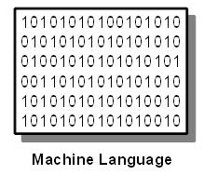
Machine Code
Machine code is the lowest-level language.
It’s as unreadable to humans as code gets – just sequences of bits.
Usually, a programmer would program in a higher-level language, like assembly language, that’s then compiled into machine language.
This is a language that only very specialized programmers ever deal with.

Slide 13
High Level Languages
Higher level languages, like Python, C, and Java, look more like human language, and are easier to understand.
They automate low-level tasks for the programmer.
For example, memory is allocated automatically.
You don’t need to ever know what memory address you’re using.
When it’s not needed any more, it’s automatically “garbage-collected” so it can be used again.
When the programmer opens a data file in Python using open(filename), the computer will begin moving part of the file from a disk to a memory buffer, so that it can be accessed faster when the programmer wants to start reading.

Slide 14
Abstracting from Hardware
High level languages also abstract away from the computer hardware.
So you don’t need to worry about different types of memory, different processors, where components are located, etc.
This is important, because computer hardware is always changing, and your code may have to run on many different types of hardware.

Slide 15

Defining Computers
Many programming classes begin by defining what a computer is.
This isn’t easy. A modern computer usually has the same components: a central processing unit, memory, input/output, but these vary.
At one time, computations were carried out by humans in large warehouses – and they were also called computers.
Notes:
You can try to prevent mistakes by having multiple computers perform the same calculations. However, humans cheat. Even when computers lived in different cities, we would later discover that they would make the exact same mistakes.

Slide 16
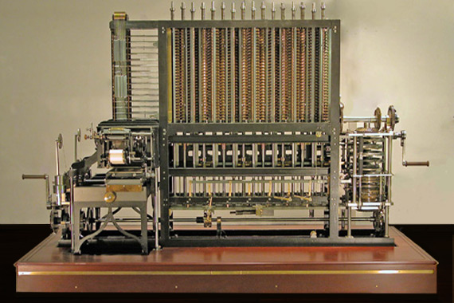
Defining Computers
Later, mechanical computers were designed, such as the difference engine, pioneered by Charles Babbage (1791 – 1871)
This had a rather limited set of instructions it could carry out.
There are 7 columns of gears that can each record a decimal number. Use a crank and numbers are added from one column of gears to the next.
You can use the difference engine to compute the value of a 7th degree polynomial, with 31 digits of precision
The idea is that it would be used to print entire tables of logarithms for use in navigation and other fields.
Notes:
Used to compute 7th degree polynomials with 31 digits of precision
Not used to calculate on the fly, but to print log tables.
First one was built in 1991.
Babbage had to team up with an engineer to develop new processes to manufacture parts with the precision he needed.
But what if you wanted to add two numbers instead? Or divide?
You only enter the data into the machine, not the program
Even during his lifetime, Babbage realized that his difference engine was limited, and turned his attention to a more powerful machine.

Slide 17
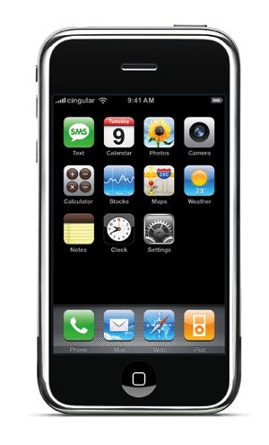


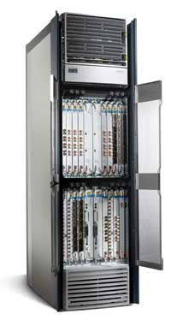
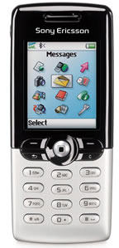
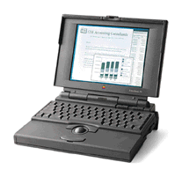

Modern Computers
Today, computers are more flexible and computing devices come in an ever greater variety.

Slide 18
Virtual Computers
A more and more computation is carried out “in the cloud.”
This means that it’s moved to giant warehouses that hold racks of computer servers.
An example is Amazon’s AWS service.
You can request a type of computer, but you don’t get to see it, since it’s in some warehouse far away.
This can be very efficient when you have a lot of calculations to perform.
For example, to process large datasets.

Slide 19
The Python Interpreter
Through all this complexity, one thing remains fairly constant.
A computer is something that executes statements in a programming language.
No matter what the underlying hardware, you can expect a computer to execute python predictably.
The computer will have a program called the python interpreter.
This program takes python statements and translates them into lower level instructions, that may be specific to the hardware its running on.
The interpreter makes sure that whatever hardware we’re running on looks the same to us as programmers.
It’s the face of the computer that we see.
Python code
Interpreter
Machine Instructions

Slide 20
Interpreted vs. Compiled
Interpreted (Python*)
Compiled (Java, C, etc…)
Source Code
Print(“hello world!”)
a = 2 + 2
s = input(“name?”)
Checker
Interpreter
Output
Source Code
Print(“hello world!”)
a = 2 + 2
s = input(“name?”)
Compiler
Object Code
Interpreter
Output
* Not 100% exactly true
Notes:
In both cases, you write something called source code – this is designed so humans can easily understand it.
In an interpreted language, a checker makes sure the source code has the right syntax, but leaves it alone.
In a compiled language, a compiler first translates the source code into object code. This is optimized so the interpreter can run it faster. Long expressions are parsed according to order of operations. Names can be translated to memory addresses.
Then why use an interpreted language? Simple, easy to debug, can add instructions on-the-fly.

Slide 21
The World of Programming Languages

Slide 22
Let’s take a look at some code in different languages:

Slide 23
Shell script
Shell script is a specialized language that lets you interact with your operating system by typing commands into terminal.
You can do basically everything you can do on your normal computer.
Things like move files around, create directories, start other programs, etc.
This was once the only way of doing these tasks
You may be used to doing these things with a graphical windowed interface (dragging and dropping, etc).
But the shell is still around and is useful for a lot of things.
We can be very precise about what we want, and automate some low-level tasks.
Depending on your operating system, there may be variations in the commands and format that you will use.
#!/bin/sh
language=0
echo "Language $language: I am the shell. So there."

Slide 24

Data-oriented Languages
Other specialized languages include those used for data analysis
R
Stata
SPSS
SAS
These languages but they treat data as a principle unit of analysis
However they make for poor general purpose languages because they’re so focused on data centric computation
Other tasks are possible may be difficult to perform (or slow, or messy..)

Slide 25
C++
C++ (and its predecessor, C) is one of the most popular general-purpose languages.
It’s used in a lot of places where speed is very important.
You can see that there’s a lot more code than Shell Script or R
For example, before we can use a variable like language in C++, we have to declare it with a statement like int language = 2. This allocates enough memory to store an integer and cannot be changed
C++ is statically typed– this means that once we declare language to be an integer, it can never hold another type of data.
This helps performance, though it reduces flexibility.
#include <iostream>
using namespace std;
int main() {
int language = 2;
cout << "Language " << language << \
": I am C++! Pay no attention to that C behind the curtain!" << \
endl;
return(0);
}

Slide 26
Java
Java is a higher-level than C/C++ but is also statically typed
It’s a very popular language in commercial and enterprise applications
It’s very verbose. You have to explicitly state how different program components interact with each other.
This is restrictive, but it makes for organized code.
public class Overlord {
public static void main (String[] args) {
int language = 3;
System.out.format("Language %d: I am Java! Scarier than C!\n", language);
}
}

Slide 27
Higher-Level Languages
These are dynamically-typed, so variables can hold different types of data at different times.
They are flexible and make for fast development.
Perl
my $language = 4;
print "Language $language: I am Perl, the camel of languages.\n";
Ruby
Popular because of web development in Ruby on Rails.
language = 5
puts "Language #{language}: I am Ruby, ready and aglow.”

Slide 28
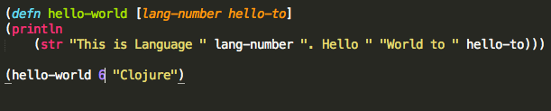
Lisps
Second oldest high level programming language used today
Uses lots of parenthesis and polish notation
Stands for “LISt Processing”
Steep learning curve but very expressive

Slide 29
Python
Python is among the highest level languages.
It’s gained popularity rapidly, since it’s so fast to develop in, and programmers generally like using it.
language = 7
print("Language %s: I am Python. What's for supper?" % language)

Slide 30
Advantages of Python
Easy to learn
Fast to develop
Used in many commercial applications
Simple syntax “Gets out of the way”
Worse performance than C or Java
But the interpreter has been optimized a lot, and the gap is not significant for most applications.
print(“hello world!”)

Slide 31
Python vs R
Suppose you are working with data, should you use Python, or a data-oriented language like R?
For a long time, data oriented computation was difficult in python
That’s changing because of the PyData libraries that we’re going to see later in this course
The syntax of python is also clean and easy to deal with, and errors are a lot easier to debug
If you’re analyzing data as part of a larger system, python makes the general programming part a lot easier
The answer is ultimately unclear Python and R both have their strengths and weaknesses

Slide 32
